Slide 1



Radar system
Using ardunio

Slide 2
Aim
This Arduino radar project aims to achieve a radar system prototype based on an Arduino board that detects stationary and moving objects. The radar system has different performance specifications, and it is also available in a variety of sizes.

Slide 3
introduction
The word RADAR means Radio Detection And Ranging. Radar is an object detection system that uses microwaves to determine the range, altitude, direction, and speed of objects within about a 100-mile radius of their location.
The radar antenna transmits radio waves or microwaves that bounce off any object in their path. Due to this, we can easily determine the object in the radar range.

Slide 4
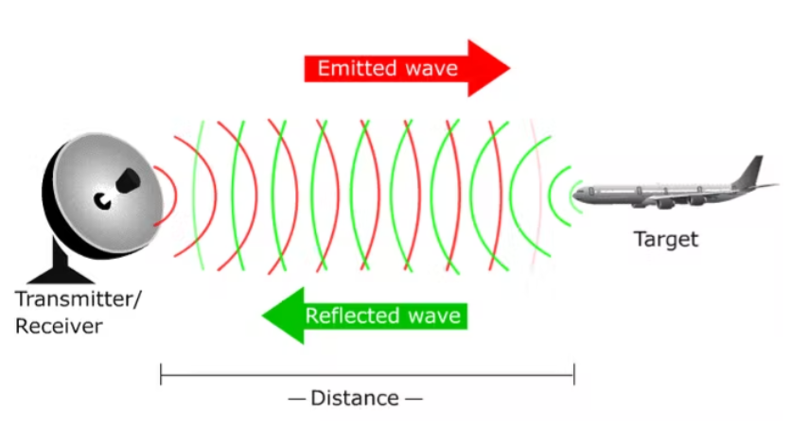

Slide 5
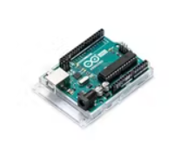
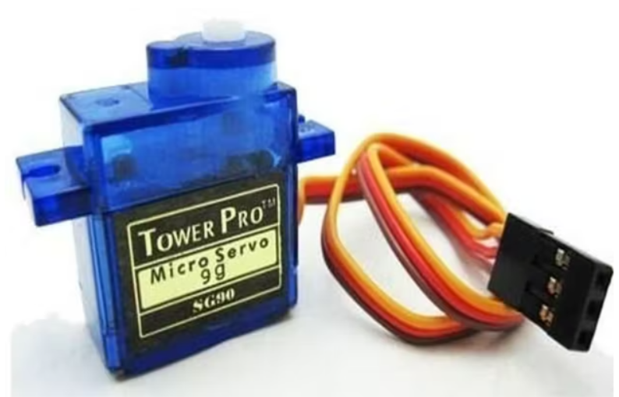
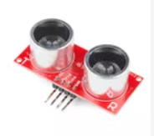
Components required
1.Arduino board
2.Ultra Sonic sensor HC-SR04
3.Servo motor

Slide 6
Applications in real life
Military
Law enforcement
Space
Remote sensing of environment
Aircraft navigation
Ship Navigation
Air Traffic Controller

Slide 7


